Slide 1

Welcome to the Tracker on-line tutorial.
Use the down arrow to advance the tutorial.
You will receive a notification e-mail advising you of your userid and password. You must change your password as soon as possible.
To log onto the system use the following URL, http://ukdunapp003/symbianttracker/LoginPage.aspx . This will take you to the log on screen as follows.

Slide 2
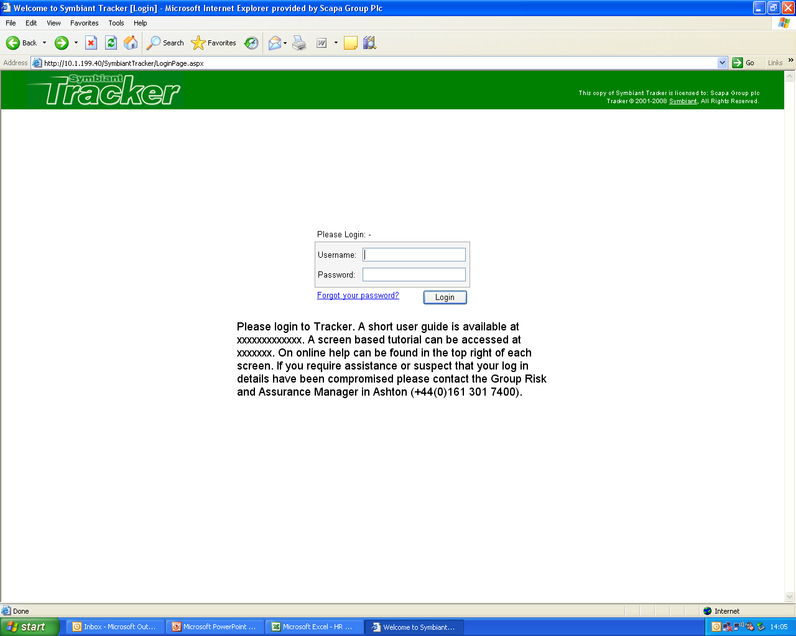
Enter your userid and password, then select “Login”. You will be taken to the Start page as follows
A short user guide is also available.

Slide 3
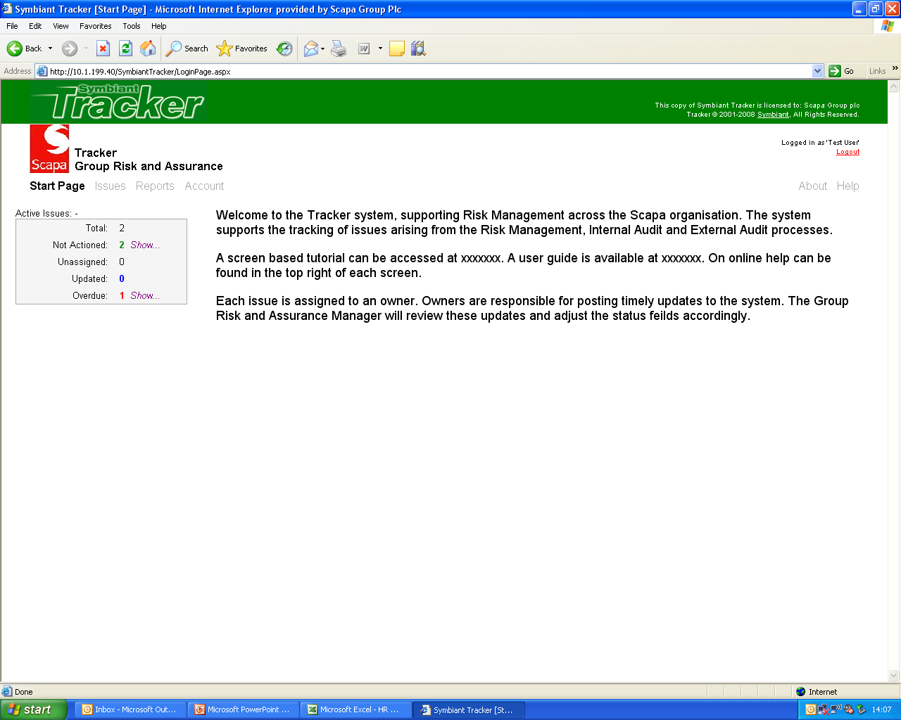
To change your password select “Account”.

Slide 4
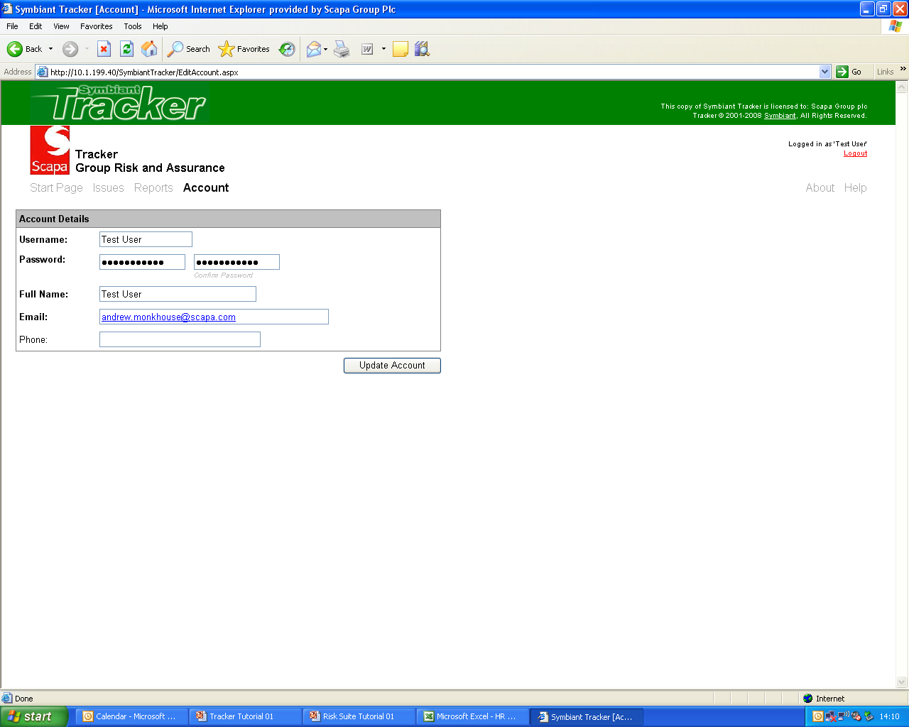
Then select “Start Page”.
Enter your new password, reconfirm and “Save”.

Slide 5
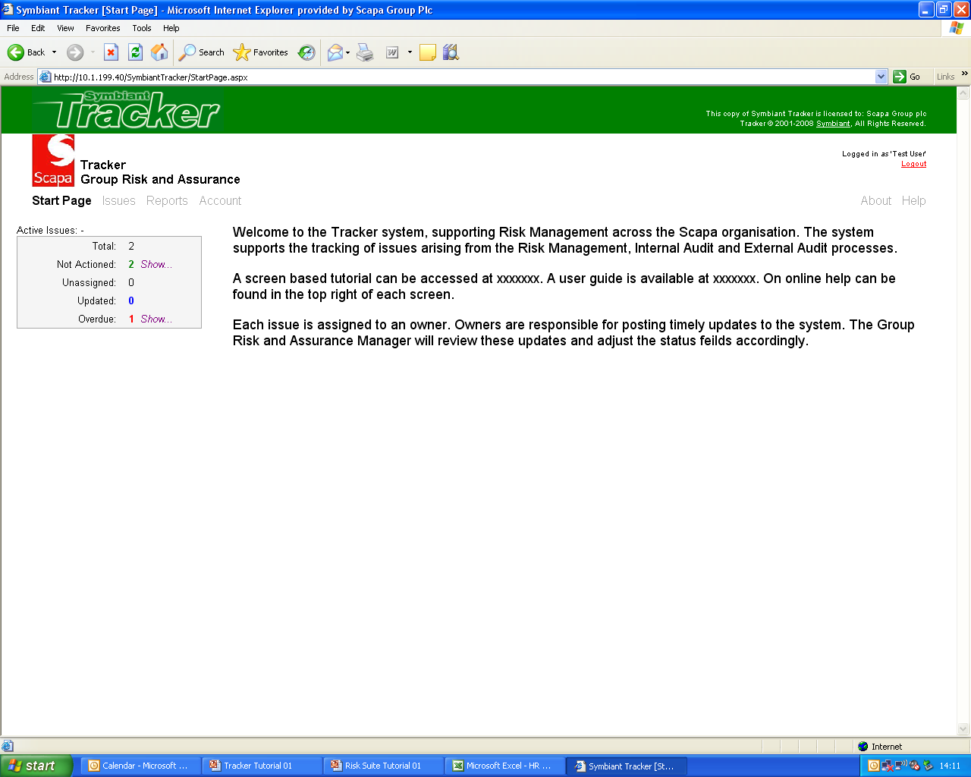
Select “Issues” to access the following screen.
The Start Page provides a summary of the issues that you have access to.
When the Group Risk and Assurance Manager loads an issue that you own, you will receive an e-mail advising that a new issue has been loaded. These will be reported in the “Not Actioned” area.
To access the issues in the individual headings click on show, or.
Issues which are overdue where the due date has passed are reported here. Owners of open issues receive a reminder e-mail two weeks before the due date expires.

Slide 6
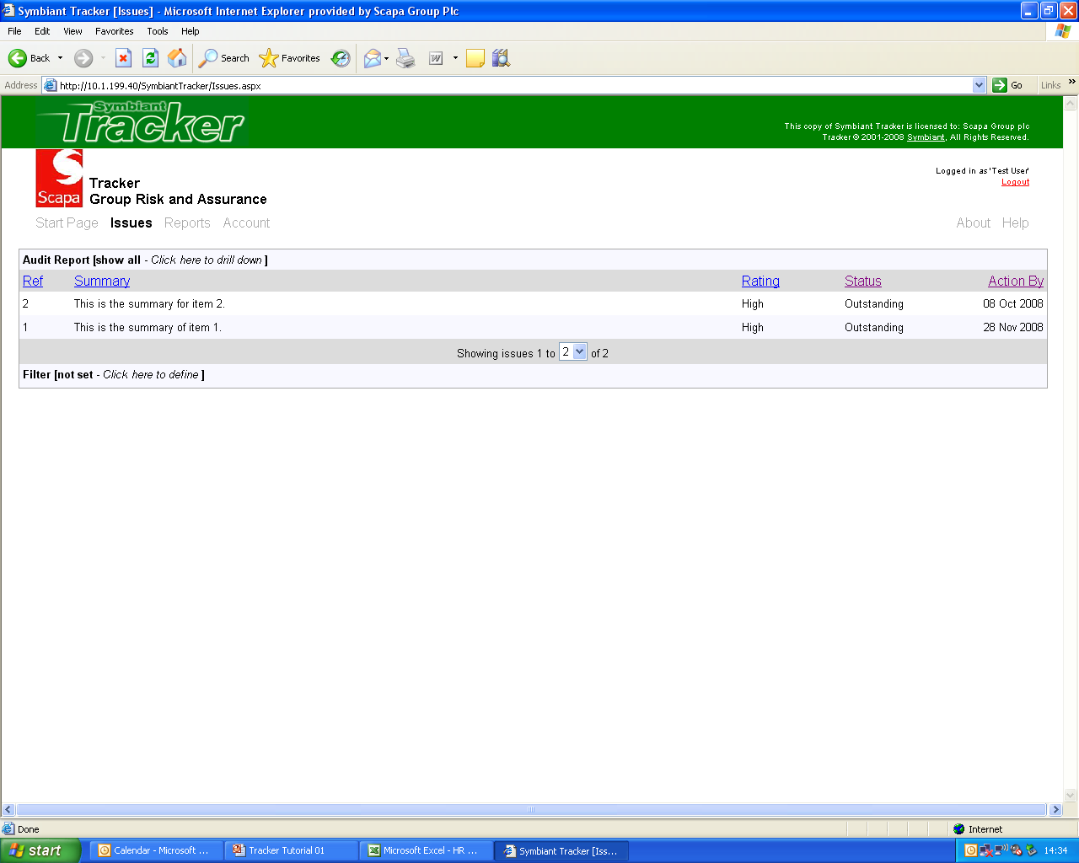
The Issues Page reports all of the issues you can see, two in this example.
Issues can be filtered by audit reports or risk areas by selecting here.
Issues can be sequenced by clicking on the column headings.
Filters can also be applied, so for example you can see only issues assigned to yourself as follows.

Slide 7
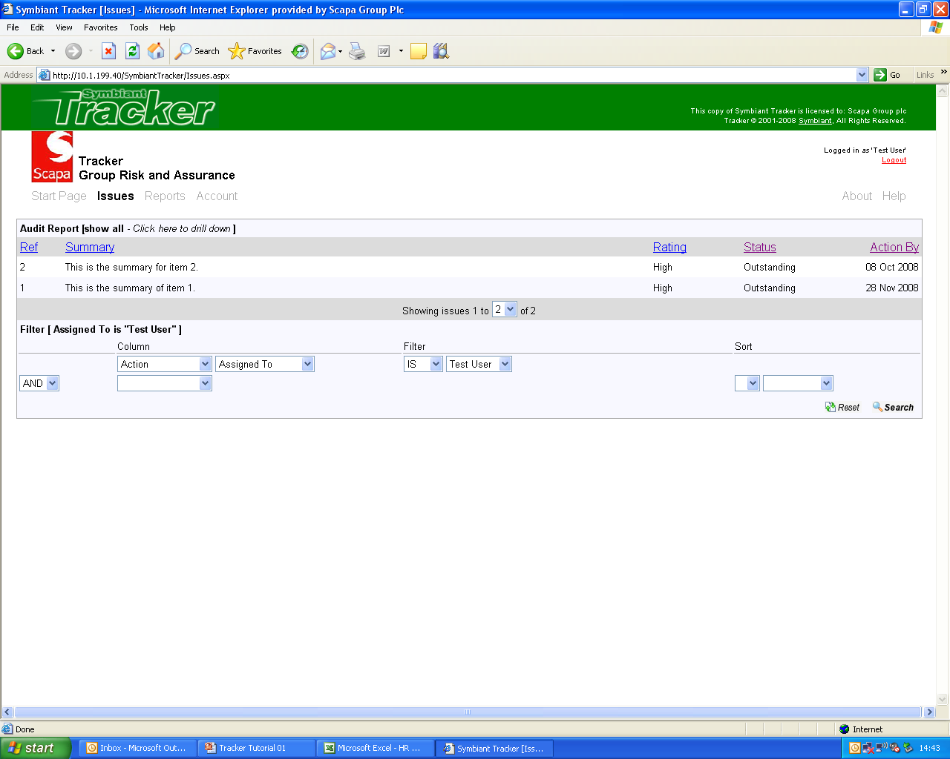
To access an issue to post an update or to see the update history, click on the required issue. This will open the Issue page as follows.
In this example, all issues owner by the “Test User” are reported. Additional filters can be applied as required.

Slide 8
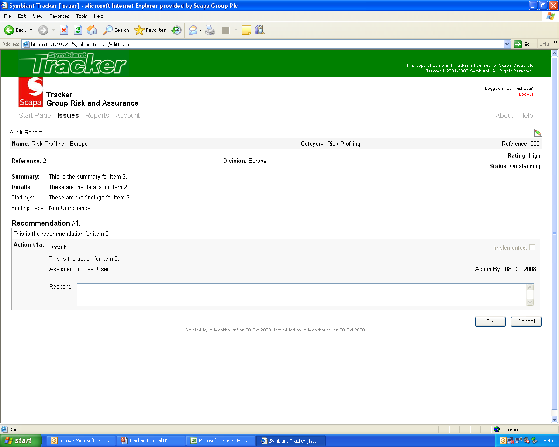
Your update should be typed in here, indicating whether or not the issue has been implemented. Be concise, but provide sufficient information to allow the Group Risk and Assurance Manager to judge whether the issue has been actioned fully, or whether a delay is expected.
This issue has been implemented. Please sign the issue off.
Then click on “OK”. Your update will be posted to the Group Risk and Assurance Manager. You will receive an e-mail if, based on their review of your update, you need to take further action. When accessing the issue you will be provided with full details of the exchange of updates.

Slide 9
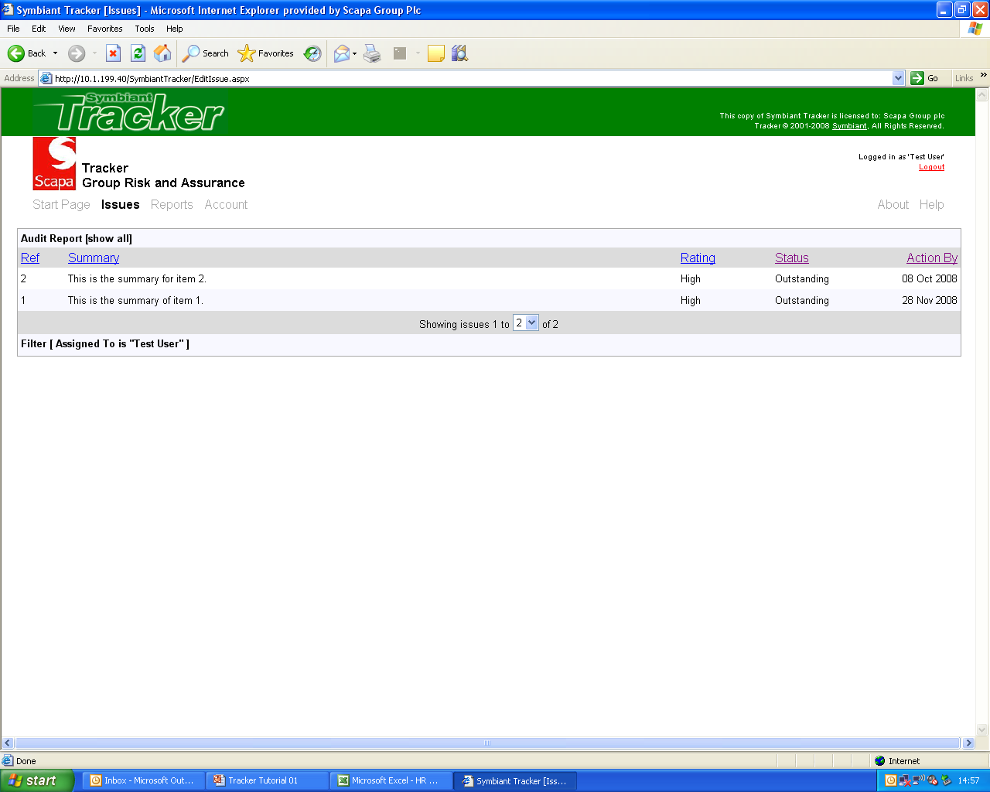
To access reporting functionality, click here.

Slide 10
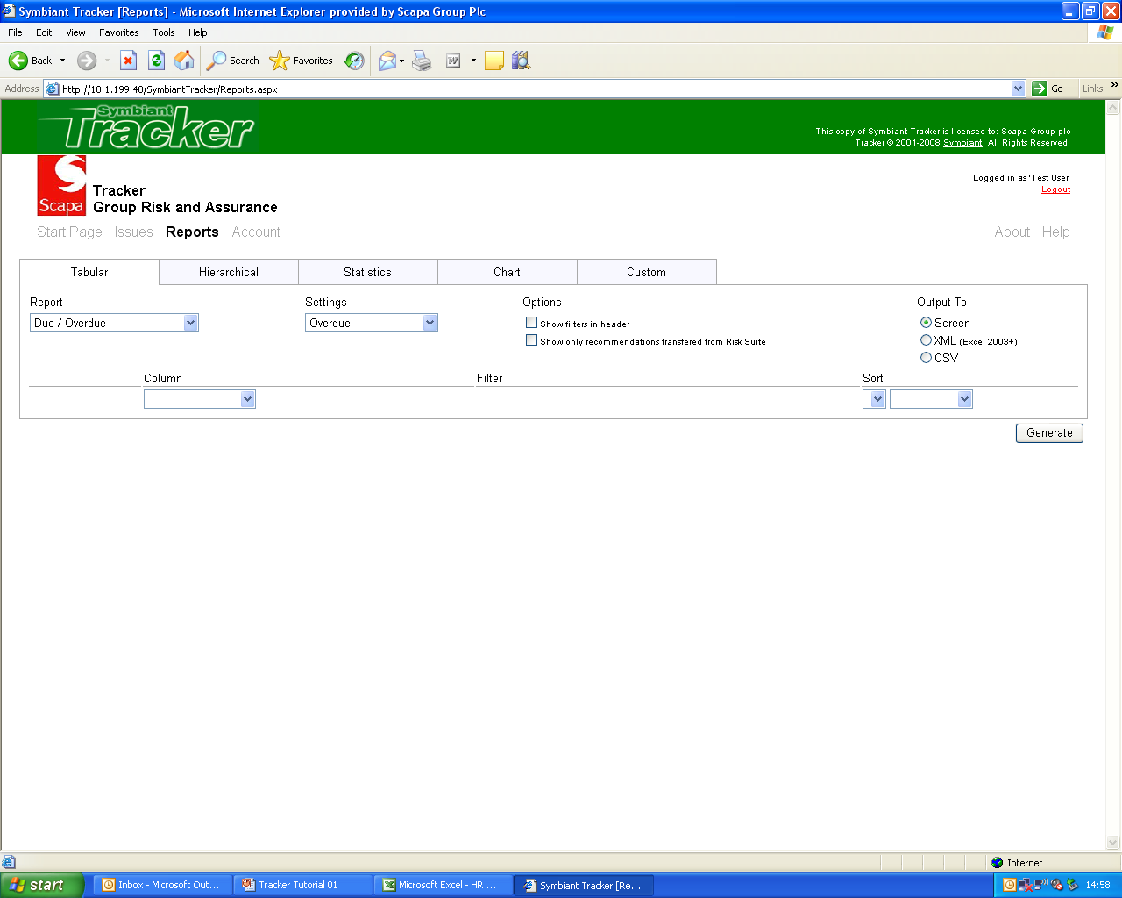
This part of the system is primarily used by the Group Risk and Assurance Manager to generate MI to support business performance reporting. However the functionality is available to all users. The “Help” facility provides full details of the standard reports and those that can be customised.

Slide 11
End of tutorial.

